Slide 1

Network Intrusion Detection System
DATA 606 Capstone in Data Science
Team – 4 :
Koushik Gadeela
Ramteja Ponnaganti
Vinay Varma Aketi
This Photo by Unknown author is licensed under CC BY-SA.

Slide 2
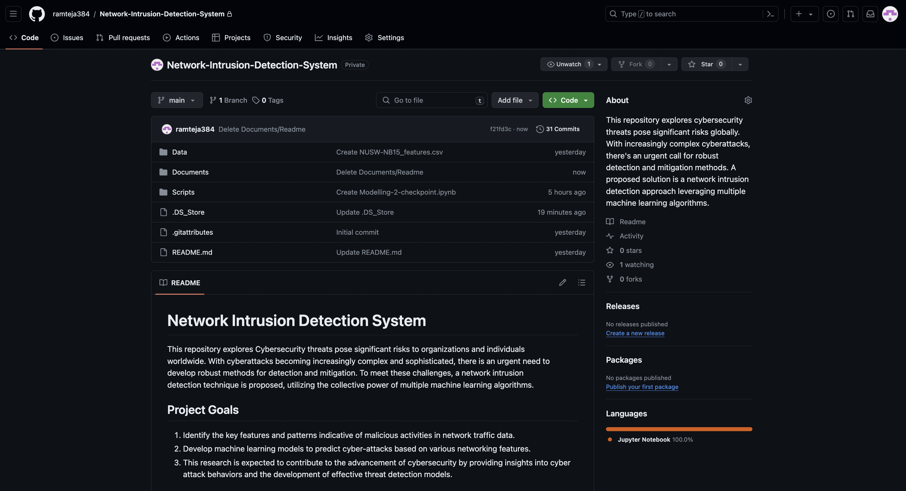
GitHub URL: https://github.com/ramteja384/Network-Intrusion-Detection-System.git
Repository Overview:
“Network Intrusion Detection System”– Amid escalating cyber threats, there's a pressing demand for advanced detection methods. We proposed a solution involves employing multiple machine learning algorithms for network intrusion detection, addressing the complexity and sophistication of modern cyberattacks
Project Impact:
Enhanced Cybersecurity Measures: By developing an effective network intrusion detection system leveraging machine learning algorithms, it could significantly bolster cybersecurity measures for organizations and individuals, helping them better protect sensitive data and networks from cyber threats.
Cost Savings for Businesses: Improved cybersecurity measures can lead to significant cost savings for businesses by reducing the potential financial losses associated with data breaches, system downtime, and damage to reputation. By investing in proactive threat detection solutions, businesses can avoid costly cybersecurity incidents.

Slide 3
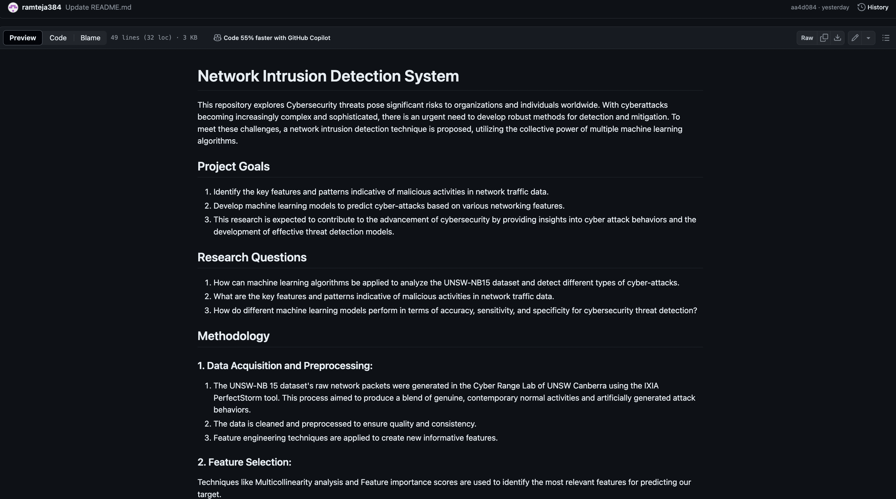

Slide 4
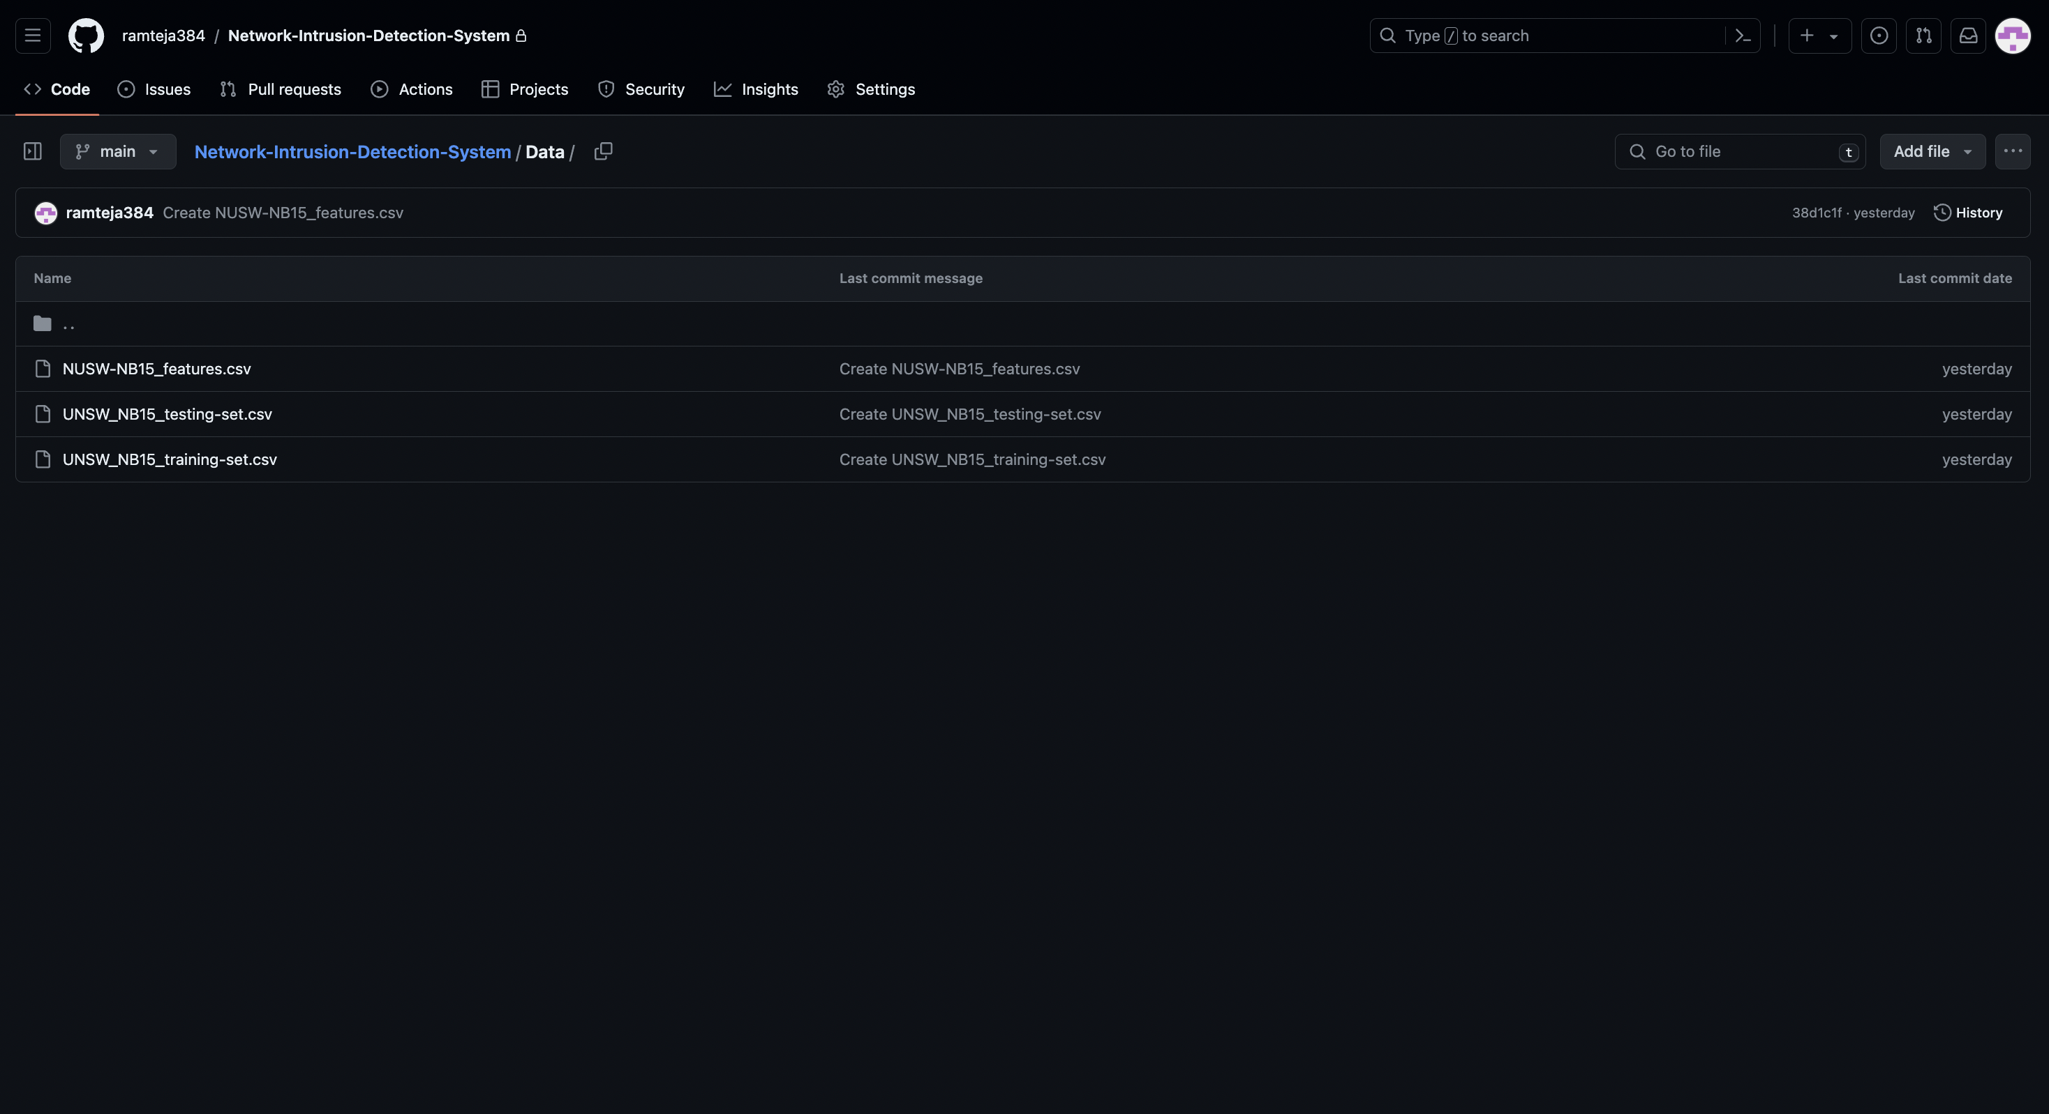

Slide 5
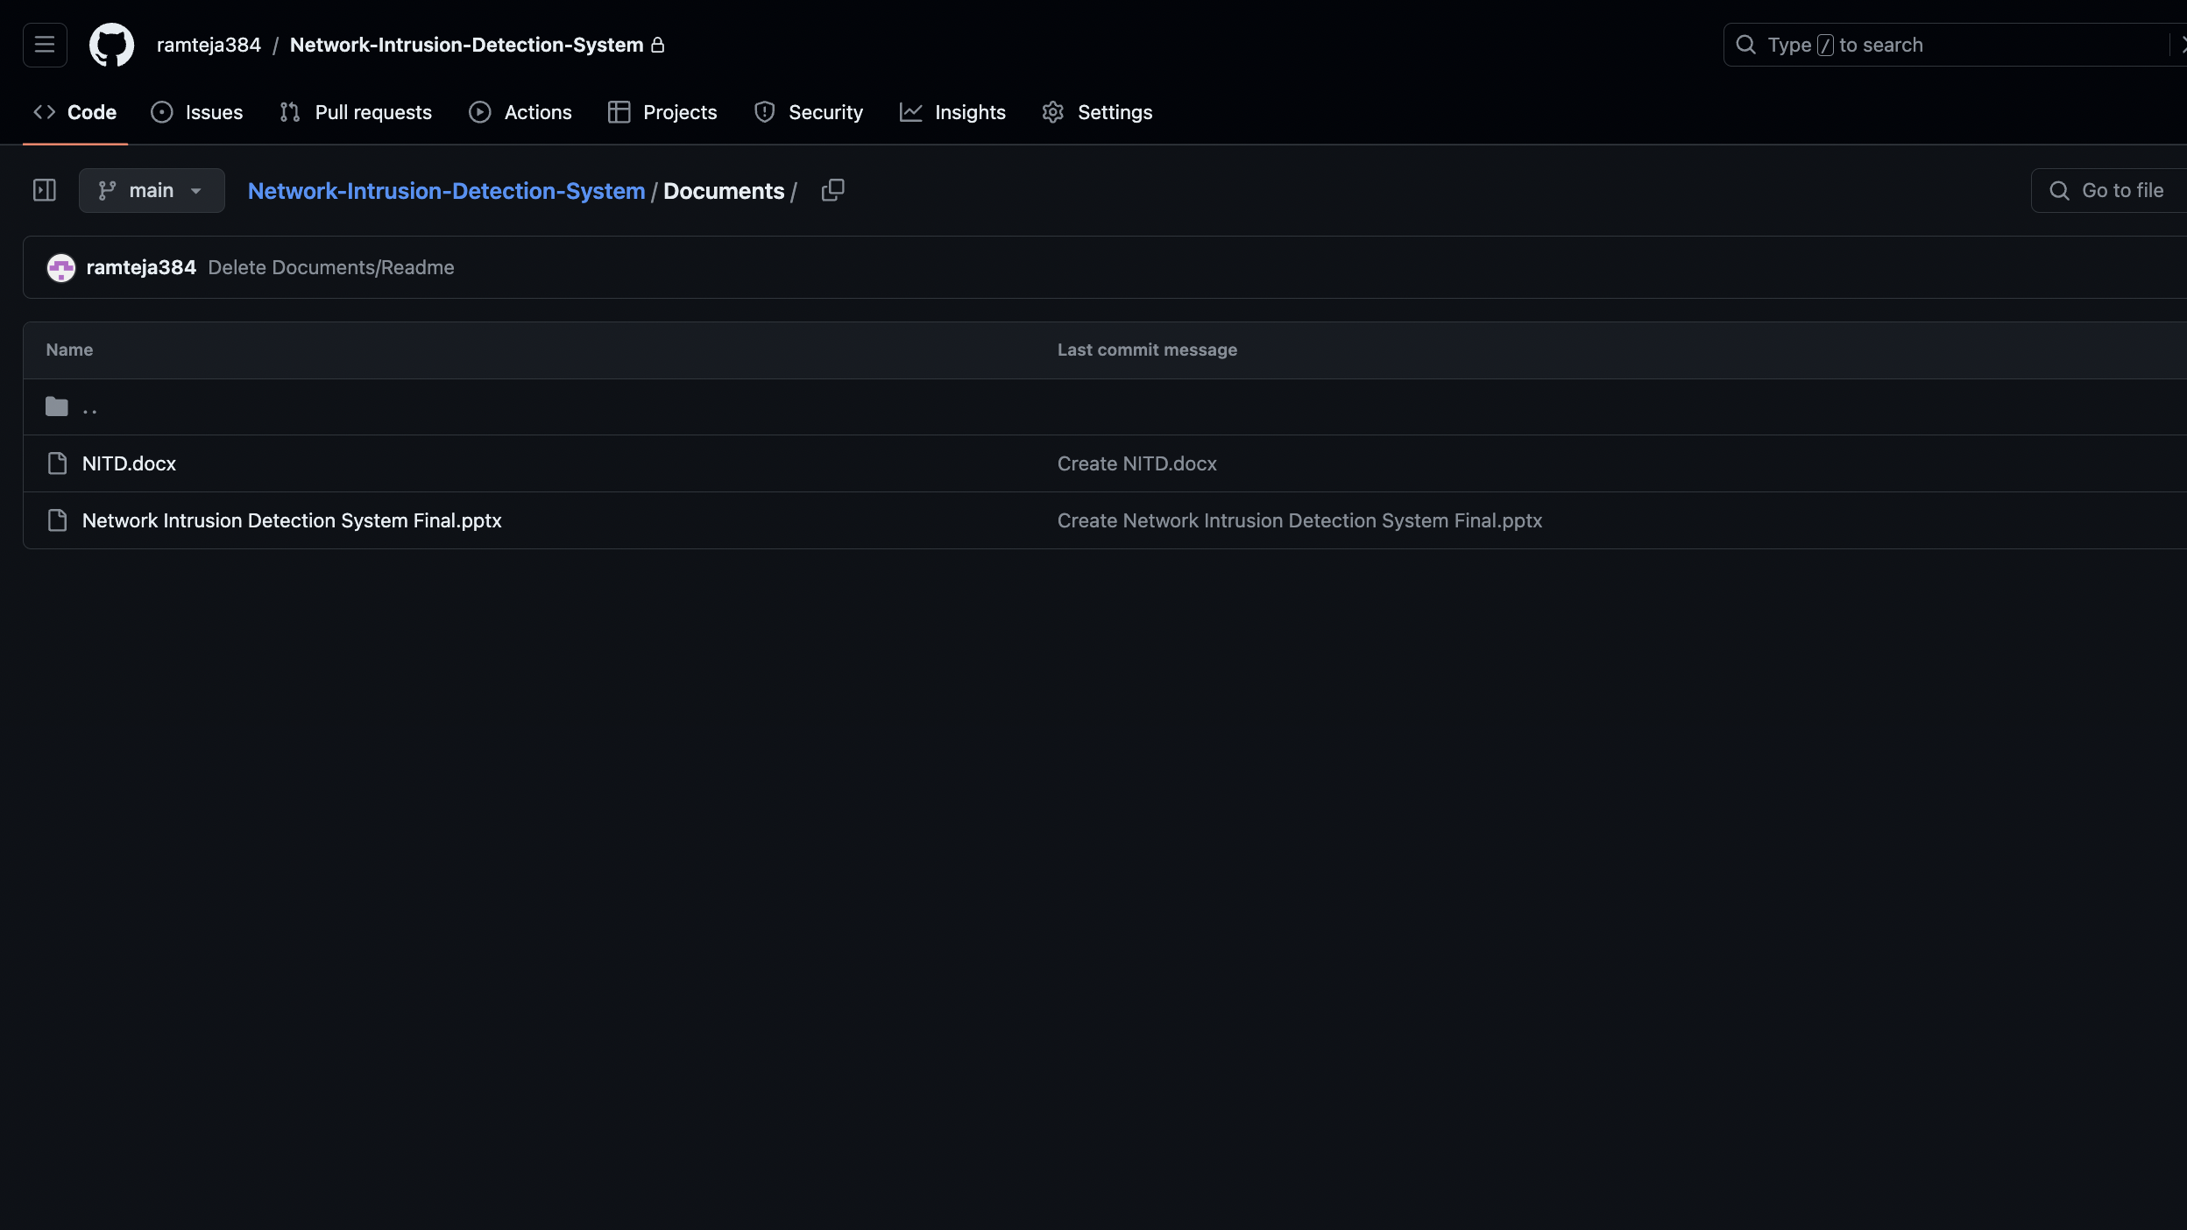

Slide 6
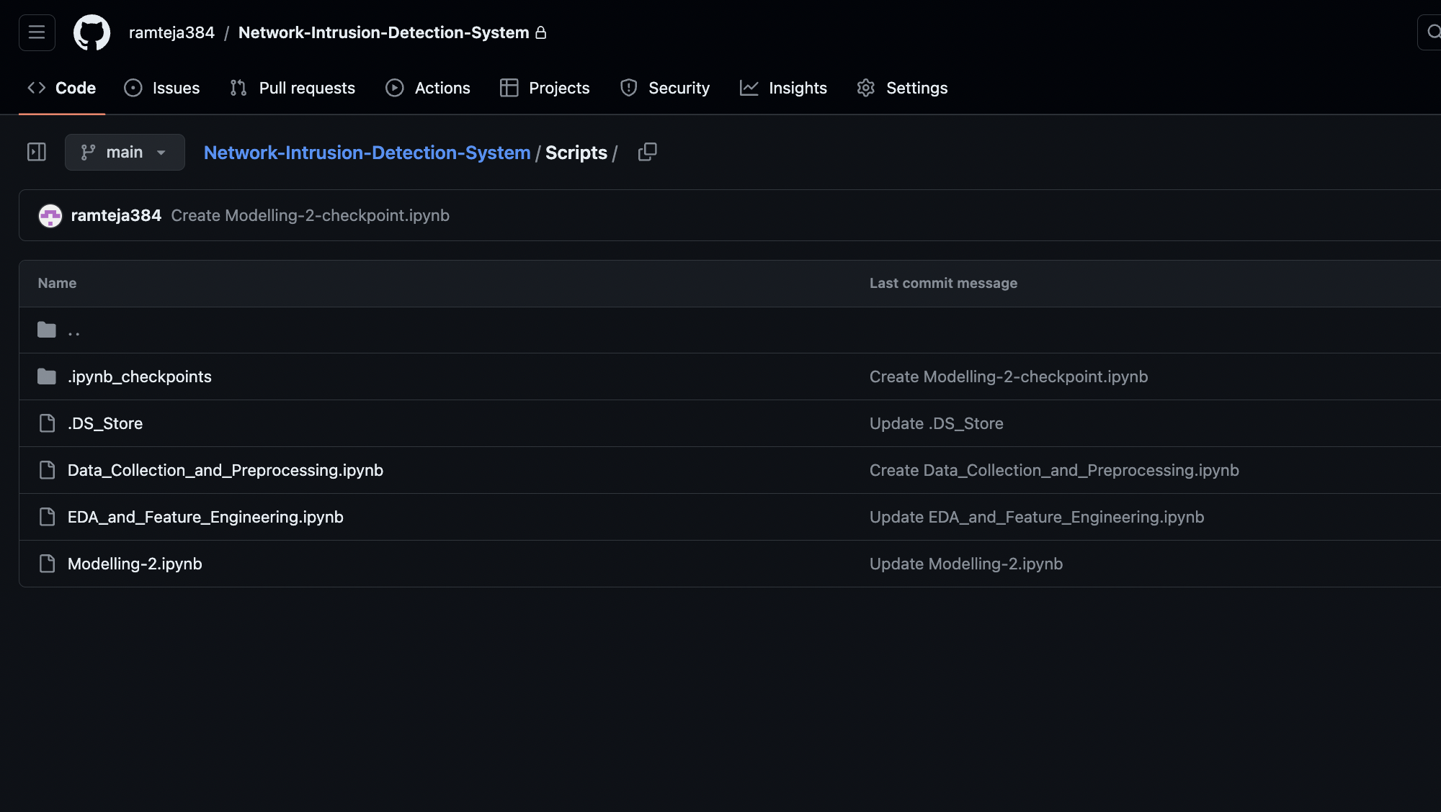

Slide 7

Future Implications
Enhanced Feature Engineering:
Deep Learning-Based Feature Learning: Utilize deep learning architectures, such as convolutional neural networks (CNNs) or recurrent neural networks (RNNs), to automatically learn discriminative features directly from raw network traffic data. For example, you can use CNNs to extract spatial patterns from packet headers or RNNs to capture temporal dependencies in network traffic sequences.
Domain Knowledge Incorporation: Collaborate with cybersecurity experts to incorporate domain knowledge into feature engineering. This could involve designing handcrafted features based on known indicators of compromise (IoCs) or leveraging expert insights to guide the selection and transformation of features. For instance, you can engineer features related to known attack signatures, network protocols, or anomalous behavior patterns.

Slide 8
Future Implications
Given the success of decision trees and random forests in achieving better performance metrics such as F1-score, accuracy, precision, and recall, here are modified future implications focusing on further enhancing these methods
Hierarchical Ensembles: Construct hierarchical ensemble structures where decision trees and random forests are combined at multiple levels of abstraction. For example, you can build an ensemble of decision trees at the leaf level and then combine their predictions using a random forest meta-learner.
Distributed Computing: Explore distributed computing frameworks, such as Apache Spark or Dask, to scale decision tree and random forest training across multiple nodes in a cluster. Distributed training can significantly reduce training times and enable the handling of larger datasets.
Model Compression: Investigate techniques for model compression and optimization to reduce the memory footprint and computational overhead of decision trees and random forests, particularly in resource-constrained environments such as edge devices or embedded systems

Slide 9
Future Implications
Real-Time Detection and Response:
Stream Processing Frameworks: Implement real-time analysis of streaming network traffic data using stream processing frameworks such as Apache Kafka, Apache Flink, or Apache Storm. These frameworks enable high-throughput, low-latency processing of data streams and are well-suited for building real-time intrusion detection systems.
Automated Response Mechanisms: Develop algorithms for automated response actions based on the detection of cyber-attacks. For example, you can integrate your intrusion detection system with network firewalls, intrusion prevention systems (IPS), or security information and event management (SIEM) systems to automatically trigger response actions such as blocking malicious IP addresses, isolating compromised devices, or generating alerts for security analysts.

Slide 10

Thank You All

